Slide 1
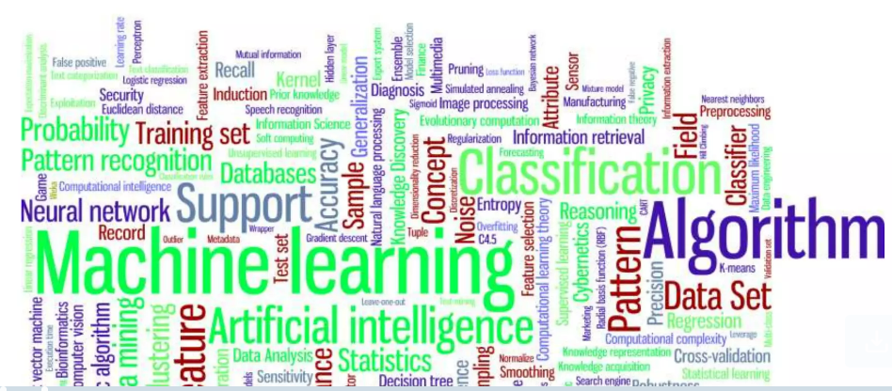
Introduction to ML
By Dr. Ali Saeed

Slide 2
Introduction to Machine Learning
Book
  Machine Learning: A Probabilistic Perspective, 1st Edition, Kevin R Murphy
Marks Distribution
  Quizzes = 10%
  Assignments =10%
  Class Participation = 10%
  Mid Term =25 %
  Research Paper/ Project= 10%
  Final = 35
Office Hours:
Tuesday: 10:30AM to 11:30 AM
Wednesday: 10:30AM to 11:30 AM
Office# A-201 (2B)

Slide 3
Definition
Machine learning is an application of AI that enables systems to learn and improve from experience without being explicitly programmed.
Machine learning is a subfield of artificial intelligence, which is broadly defined as the capability of a machine to replicate intelligent human behavior.
Machine Learning Is a Form of Artificial Intelligence that Makes Predictions from Data.

Slide 4
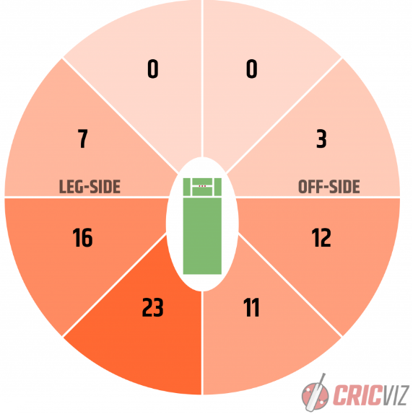
Example cricket match to predict next short

Slide 5
Application of ML
Image Recognition
Speech Recognition
Traffic prediction
Product recommendations
Self-driving cars

Slide 6
Why Now
Due to large digital data
Increasing power of computer
Growth of available algorithms
Increasing support of industry

Slide 7
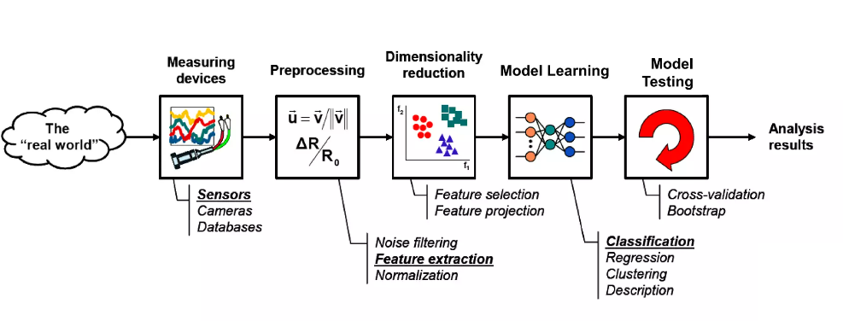
The Learning Process

Slide 8
Types of Machine Learning
Supervised Learning
  Classification
  Regression
Unsupervised Learning
  Clustering

Slide 9
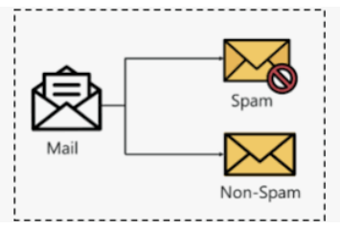
Classification
A classification is a division or category in a system which divides things into groups or types.

Slide 10
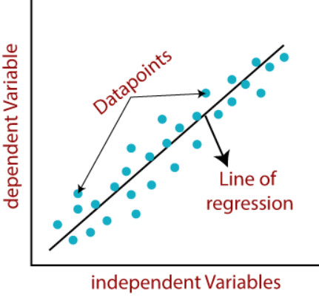
Regression
Regression is a technique for investigating the relationship between independent variables or features and a dependent variable or outcome.

Slide 11
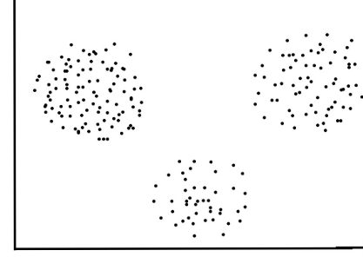
Clustering
Grouping unlabeled examples is called clustering. As the examples are unlabeled, clustering relies on unsupervised machine learning.

Slide 12
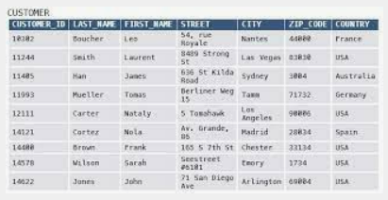
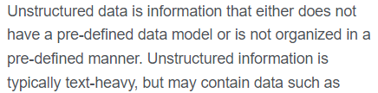
Datasets
Structured Dataset
  Structured data is highly-organized and formatted so that it's easily searchable in relational databases.
Unstructured Dataset
  Unstructured data has no predefined format or organization, making it much more difficult to collect, process, and analyze.

Slide 13
Thanks

